Slide 1
A Multi-Language Audio Retrieval System for Code-Switched French-Swahili-Lingala Mix in Eastern DRC
Athanase BAHIZIRE & Stephen N'nouka
Notes:
Comment from Prof.
We can consider using another language, let's say English Swahili, and compare.
Look at existing literature, on audio retrieval, ... and applied on sentiment analysis.

Slide 2
THE PROBLEM
The specific challenge in Eastern DRC is the fluid, trilingual nature of the Swahili spoken there. Unlike "Standard Swahili," the local variety incorporates French (for technical/official terms) and Lingala (for slang, emphasis, or cultural nuance).
The Problem: Current AI retrieval systems are "monolingual-centric." If a citizen records a voice note in Goma or Bukavu saying:
"Njo maana ba politiciens bana utiliser lingala pamba pamba juh yaku distraire batu" (That's why politicians use Lingala just to distract people), a standard model fails.
The Gap: The model will have difficulties to map the French word "politiciens", the Lingala phrase "pamba pamba", and the Swahili syntax into a single semantic vector.
This makes it difficult for local stakeholders to perform cross-modal searches, such as searching for "political corruption" via text and successfully finding this specific audio clip.

Slide 3
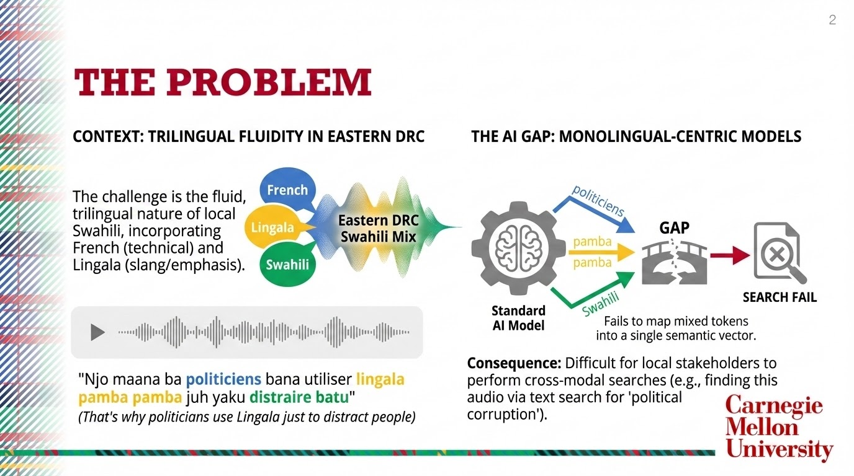

Slide 4


Stakeholder Relevance & SDGs
Civil Society & Peacebuilders: To detect rising tensions or rumors in local radio and "street" speech before they escalate into physical conflict.
Electoral Commissions: Monitoring political discourse that frequently switches between languages to target different ethnic groups or bypass standard keyword filters, in tension context.
SDG 16 (Peace, Justice, and Strong Institutions): Building tools to monitor incitement and hate speech in the actual language of the people, we strengthen regional stability and accountability.
SDG 9 (Industry, Innovation, and Infrastructure): Developing "Afro-centric" AI infrastructure that doesn't require users to speak "pure" languages far from our reality to be digitally visible.

Slide 5
Dataset Strategy
Dataset | Primary Use in Project
Gamayun French - Swahili (Congo) Kit: | Provides the specific Swahili-French code-switching pairs common in the DRC. [Masakhane: 10,305 sentences]
Hate Speech Kenya | Used for Transfer Learning; the Swahili-English code-switching patterns help the model learn the "logic" of switching between two different grammars. [Kaggle: 48,076 tweets]
Google Waxal NLP | Crucial for Lingala & Swahili audio. We will use this to ground our text models in real Congolese phonetics and audio signatures. [by Google on Huggingface: 1,250 hours natural speech]
Swahili News Classification | Will serve as the "Formal Baseline" to ensure the model maintains high accuracy for core Swahili vocabulary. [Kaggle: 6,439 news]

Slide 6
Experiment Plan
Candidate Models
Retrieval Tasks
Evaluation Metrics
Serengeti
AfriBERTa
CLAP (Contrastive Language-Audio Pretraining)
CLASP (Contrastive Language-Speech Pretraining)
Text-to-Text (T2T): Query: "Corruption" (French) Result: "Kula rushwa na pamba pamba" (Swahili/Lingala mix).
Audio-to-Text (A2T) / Text-to-Audio (T2A): Query (Text): "Conflict" Result (Audio): A voice note clip containing "...batu ya bitumba..." (Lingala/Swahili mix).
Mean Reciprocal Rank (MRR): To measure how high the "correct" concept appears in search results across the mix.
Code-Switching Robustness Score: Measuring the drop in retrieval accuracy as the percentage of mixed-language tokens increases.

Slide 7
Candidate Models
Serengeti: A massively multilingual model covering 517 African languages. We will use it as the primary text encoder to see if its broad linguistic base captures the nuances of the DRC mix.
AfriBERTa: A model specifically optimized for low-resource African languages. We will use this to generate text-to-text embeddings for our retrieval task.
CLAP (Contrastive Language-Audio Pretraining): We will fine-tune a CLAP-based architecture using Waxal NLP to align audio signals with text embeddings.
CLASP (Contrastive Language-Speech Pretraining): An alternative designed for audio-text information retrieval that often handles multilingual data more efficiently than traditional ASR.

Slide 8
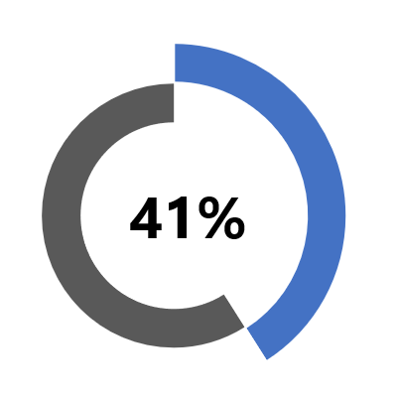
Comparison With English-Swahili
We are currently exploring existing literature on audio retrieval and sentiment analysis.
We are currently exploring the availability of audio datasets.
We can consider using English-Swahili for a language comparison.

Slide 9
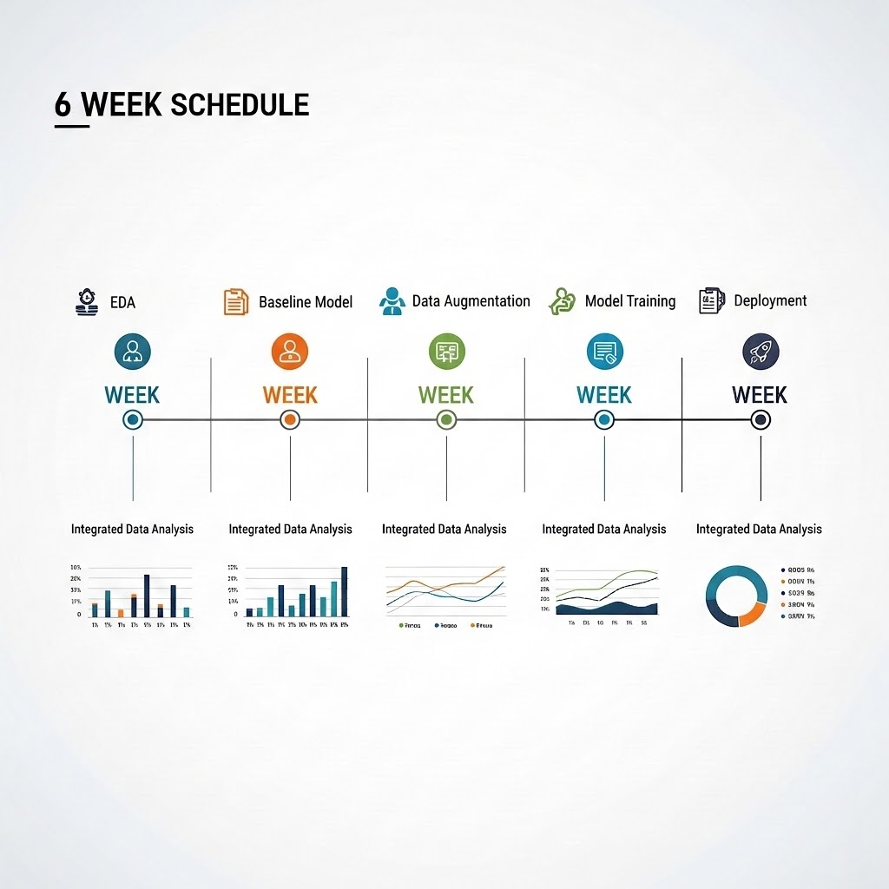
Project Timeline
To be able meet the end of semester requirement, Six weeks are allocated for project progress tracking.
The initial phase of the project is Exploratory Data Analysis.
Baseline experimentation follows the initial data analysis phase.
Data augmentation techniques are applied after baseline testing.
Experiment tests and final analysis will conclude the project.

